Slide 1
Establishing
Personal Learning Environments on tablet computers: enhancing the student experience through HE/FE and beyond: exploring the implications
Brian Whalley
University of Sheffield
b.whalley@sheffield.ac.uk
brianbox.net

Slide 2
A discussion
Involving you, colleagues, students
So:
Think about the two good/better/best/ideal things that your institution could do/deliver/instigate etc to make your job easier/better/
Write them on a PostIt, (with your job title at the top) and pass them forward.
Meanwhile: close your eyes, and imagine what reality is likely to be like, what are the impediments?
(keep these to yourself for the moment!)

Slide 3
The ‘Knowledge’ or DIUKW Pyramid
Wisdom
Intelligence
Human, judgmental
Knowledge
Contextual, tacit
Transfer needs learning
Information
Codifiable, explicit
Easily transferable
Data

Slide 4
Conceptions of Information Literacy in an International Context (BLDS)
4-6 September
Chat Literacy Network
community.eldis.org/.59e9ac6e/

Slide 5
Day 1: What is information literacy?
explores conceptions of IL in different contexts and domains:
differences, for instance, between its application in scientific research and the social sciences;
help identify the skills, knowledge, behaviour associated with IL;
discuss standards, models and frameworks that can be applied.

Slide 6
Day 2: What is the link between information literacy and research skills?
What role does IL play in developing the skills of the young researcher or an effective employee?
critical link between IL and building research capacity; sharing approaches and strategies for mitigating challenges,
raising awareness and communicating the value of IL in your organisations.

Slide 7
Day 3: What are the effective tools and approaches used in teaching information literacy?
Share your experiences of teaching IL and measuring the impact of your training
Changing behaviour and building lifelong learning skills requires a unique learning approach
What tools and approaches have worked most effectively in your context?
challenges of teaching large and increasingly remote learners?
What innovative approaches are you using to engage the learner in IL?

Slide 8

Who said this and when?
The kind of organisation we wish to aim at is one in which all relevant information should be available to each research worker and in amplitude proportional to its degree of relevance.
Further, that not only should the information be available but also that it should be to a large extent put at the disposal of the research worker without his having to take any steps to get hold of it.
J.D. Bernal (the Sage)
1939!

Slide 9
UNESCO (2002)
individuals who,
‘know when they need information, and are then able to identify, locate, evaluate, organise and effectively use the information to address and help resolve personal, job related, or broader social issues and problems.’
JISC - Digital Literacy – to "define those capabilities which fit an individual for living, learning and working in a digital society"
Digital and Information Literacy
Which is probably what Zonker needs …

Slide 10
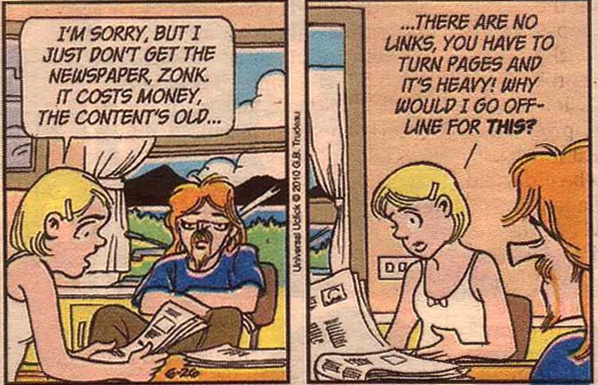
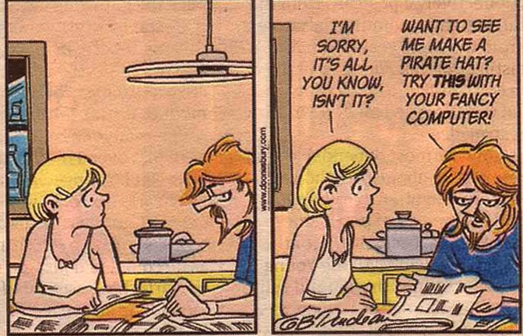
Where are we now?
and where might we be going?
Gary Trudeau,
‘Doonesbury’,
Guardian, 2012

Slide 11
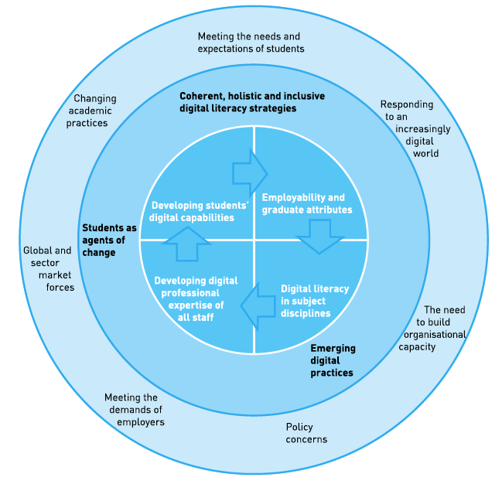
JISC
Developing
Digital
Literacies
Briefing Paper
June 2012

Slide 12
So,
Where
Developing
students’
digital
capabilities
Employability
and
graduate attributes
Developing digital
professional
expertise of
all staff
Digital literacy
in subject
disciplines
Do YOU
Come in?

Slide 13
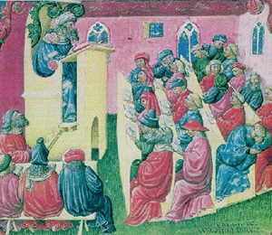
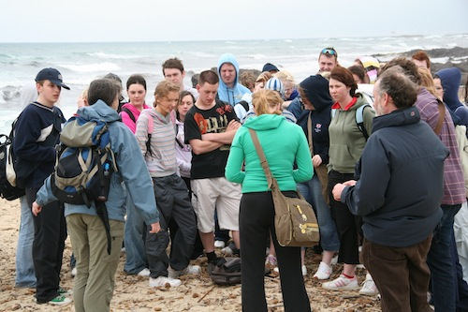
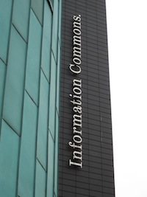
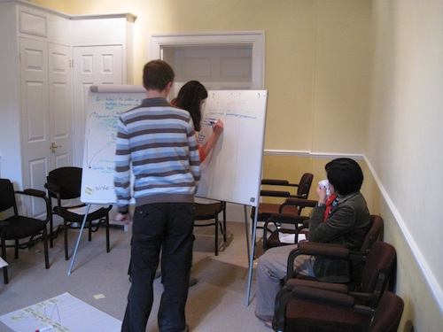
Personalised learning? in personal learning spaces?
How do we personalise and in what learning spaces?

Slide 14
And for learners:
‘Everyone should be able to participate and control their own learning process’
(Knowles 1987)
Does a VLE (really) allow this?

Slide 15
Learning Spaces, where are we going to?
Libraries, lecture room, study spaces
VLE
PLE
Some concepts of space and thought and the integration
of facts, learning and understanding (in a spatial world)
‘Learning takes place through the active behavior of the student: it is what he does that he learns, not what the teachers does.’ (Tyler, 1949 in McLuhan 1965)

Slide 16
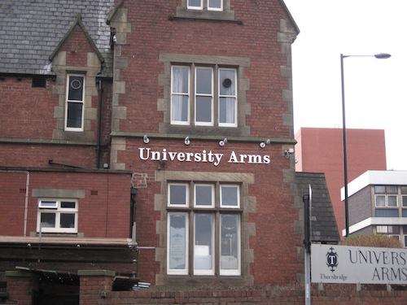
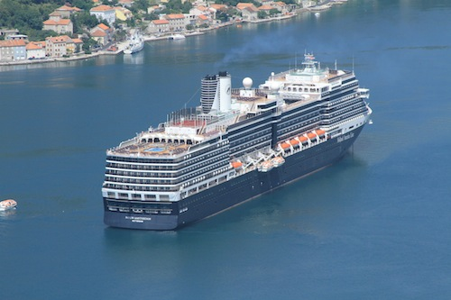
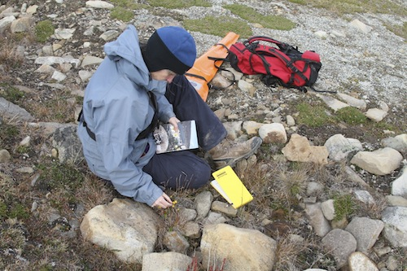
Personalising in various learning spaces…..

Slide 17
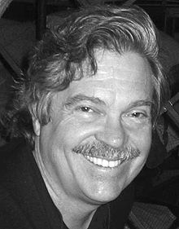


Some people and their concepts
Alan Kay –
The Dynabook
"The best way to predict the future is to invent it."
Neal Stephenson –
The Young Lady’s
Illustrated Primer
(Diamond Age)
Douglas N Adams –
The Hitch-Hiker’s Guide to the Galaxy
- ‘The Book’

Slide 18
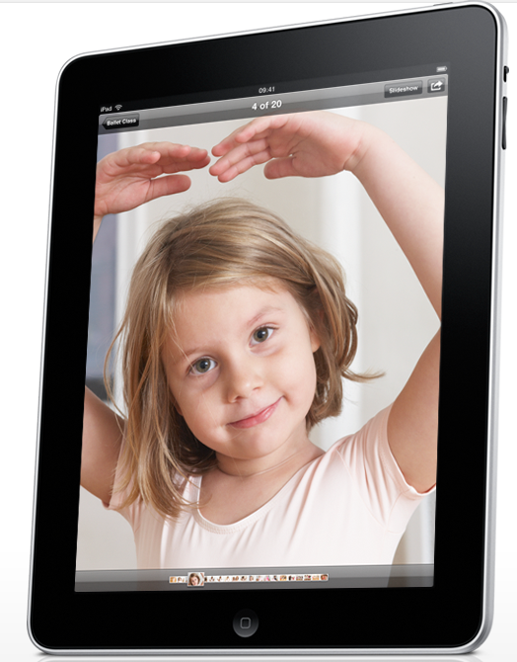
The Young Lady’s
Illustrated Primer
The Young Lady’s
Illustrated Primer
The Book?
Not just yet

Slide 19
Personal Learning Environment
A definition:
As such, a PLE is a single user’s e-learning system that provides access to a variety of learning resources, and that may provide access to learners and teachers who use other PLEs and/or VLEs.
Mark van Harmelen 2006
(NB ‘ideas about PLEs are still forming’)
Work by Scott Wilson and Stephen Downes
Technology Enhanced Learning (Dillenbourg)
Notes:
Personal Learning Environments Mark van Harmelen School of Computer Science, University of Manchester mark@cs.man.ac.uk
Proceedings of the Sixth International Conference on Advanced Learning Technologies (ICALT'06)
W*
Personal Learning Environments are systems that help learners take control of and manage their own learning. This includes providing support for learners to
* set their own learning goals
* manage their learning; managing both content and process
* communicate with others in the process of learning
and thereby achieve learning goals.
Early work by
Oleg Liber
Scott Wilson
Stephen Downes

Slide 20
Alphabet Soup ……
WiFi - Wireless Fidelity (network)
WLAN - wireless local access network
DITF - Digital Inclusion Task Force
OFCOM - Independent regulator and competition authority for the UK communications industries
LTE - Long Term Evolution (4G) 300Mbit/sec (MIMO)
HSPA - High Speed Packet Access - 3G
PLE - Personal Learning Environment (vs VLE)
GLE - group lesrning Environment
PLS - Personal Learning Space
iPP - iPhone, iPad (Galaxy, Surface etc)
(and the next iWotsits that escape the Big Apple’s lawyers)
BYOD - Bring your Own Device

Slide 21
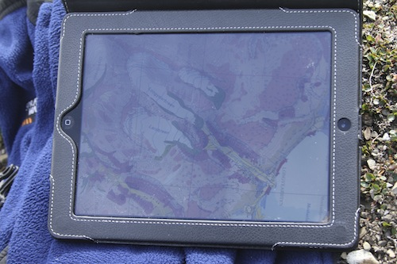
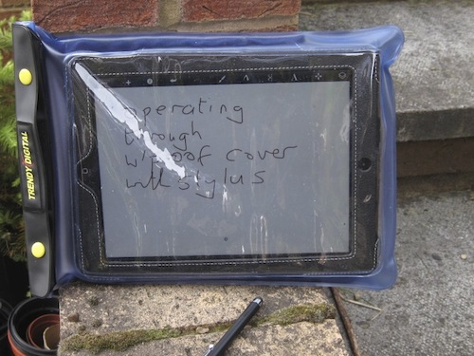
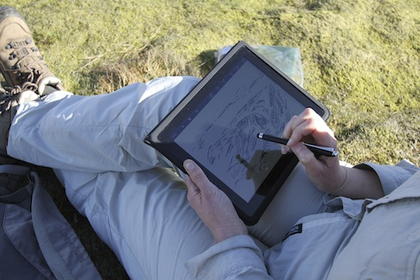
iPad use and usage….
And it does not have to be internet connected

Slide 22
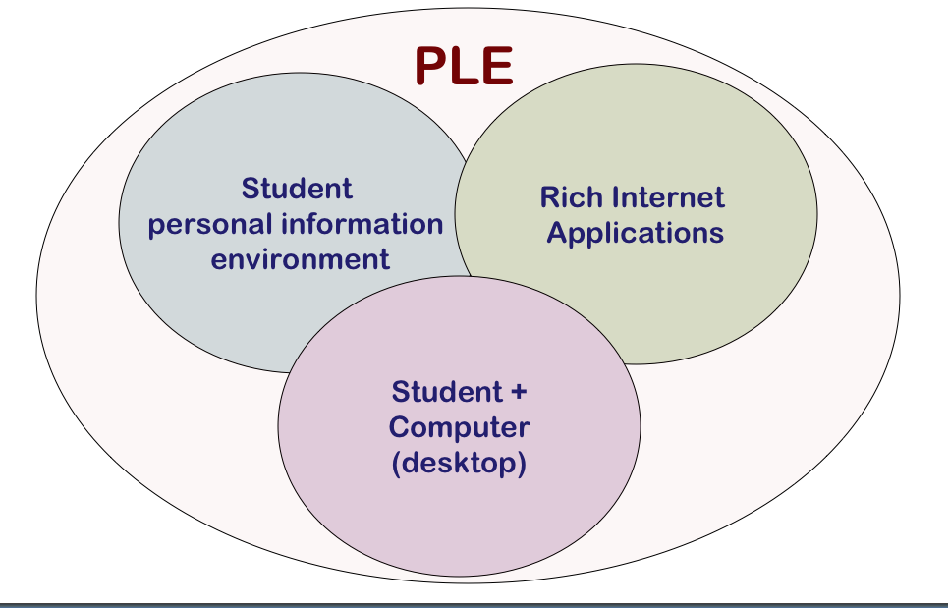
Cloud
Apps
Apps
Netbook/iPad etc
WiFi/3G/Bluetooth

Slide 23
Some Questions to academics
1 Do you have an ‘ethernetted’ computer on your desk?
2 Do you use electronic mail regularly?
3 Do you use electronic bibliographic databases regularly?
4 Do you browse the WWW regularly for useful teaching or research material?
5 Do you use multimedia materials for teaching?
6 Do you browse your library’s current periodicals shelves regularly?
7 Has your library maintained all its periodical subscriptions?
W B Whalley 1995 Computers and Geoscience Communication, Geologic, in Terra Nova 7, 6 641-644.
Notes:
W B Whalley 1995 Computers and Geoscience Communication, Geologic, in Terra Nova 7, 6 641-644.

Slide 24
Personal information strategy
Information
needs
Information use
Outputs
Report
Talk
Letter
etc..
Search tools
metadata use
regular
RSS feeds
immediate
Web:
Google Scholar
Wikipedia
Process
Ad hoc
Read
Redirect
Process
Save/file/trash
Review later
Sociability
43 things
Flikr
digital
human
requested
Sources
E-books
unsolicited
Memory
Grey cells?
Computer
(Connected) laptop
PDA
Mobile
Filter
paper
Books
Reusable Educational Objects
Bibliographic & image tools

Slide 25
Stephen Downes
"... one node in a web of content, connected to other nodes and content creation services used by other students. It becomes, not an institutional or corporate application, but a personal learning center, where content is reused and remixed according to the student's own needs and interests. It becomes, indeed, not a single application, but a collection of interoperating applications — an environment rather than a system".
Also contributions by Graham Attwell, Scott Wilson and Mark van Harmelen
Notes:
E-learning 2.0 Stephen Downes 2005, http://www.elearnmag.org/subpage.cfm?section=articles&article=29-1

Slide 26

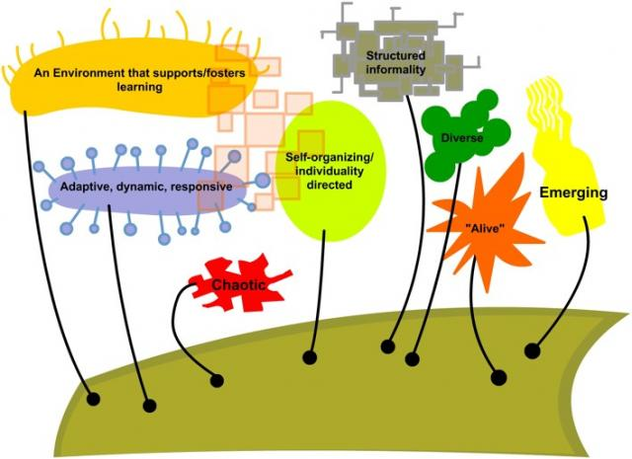
The categories of human thought are never fixed in any one definite form; they are made, unmade and remade incessantly; they change with places and times. Emile Durkheim
Connectivism
"theory that learning consists of making the right connections." George Siemens and Stephen Downes
Notes:
If you have not met connectivism before then http://en.wikipedia.org/wiki/Connectivism will give you a good idea. The point I want to make is that, in real life, we need frameworks and tools to help us manage, in our individual ways) the mass and complexity of the information world. See John Seely Brown (JSB) and Paul Duguid, 2002, ‘the Social life of information’

Slide 27
BYOT & BYOD
Devices each student is likely to have within a technological remit
Some implications ……..
Already in schools
Students will want to use WiFi ‘everywhere’
Institutions can save (some) money by reducing computer suites (and what are students using these computers for anyway?)
Do institutions need to spend money on major software?
Do they need lecture halls?
How do they deliver DIL skills? (back to JISC)

Slide 28
What scenario?
In the area of e-books, libraries are, I believe, confused about what they want, particularly in terms of business models. ….
Do libraries want to regress to emulating the printed book? Or do they want to use digital books within a site license framework as an extension of current trends, treating e-book readers as just another display technology that their patrons may exploit?
Or do libraries want some new hybrid solution that permits, for example, the acquisition of "peak load" copies of popular works for circulation for a limited time when they are popular and in high demand?
Lynch, 2001
Notes:
The full quote:
In the area of e-books, libraries are, I believe, confused about what they want, particularly in terms of business models. Assume that standards are resolved. E-book appliances (and probably even software readers) can potentially mimic the behavior of books - the library can acquire one, a single person at a time can view or borrow, and returns can even be automatic (access revocation). This is very different from site license to digital content, which has been the primary model for electronic information for the past few years. Do libraries want to regress to emulating the printed book? Or do they want to use digital books within a site license framework as an extension of current trends, treating e-book readers as just another display technology that their patrons may exploit? Or do libraries want some new hybrid solution that permits, for example, the acquisition of "peak load" copies of popular works for circulation for a limited time when they are popular and in high demand?

Slide 29
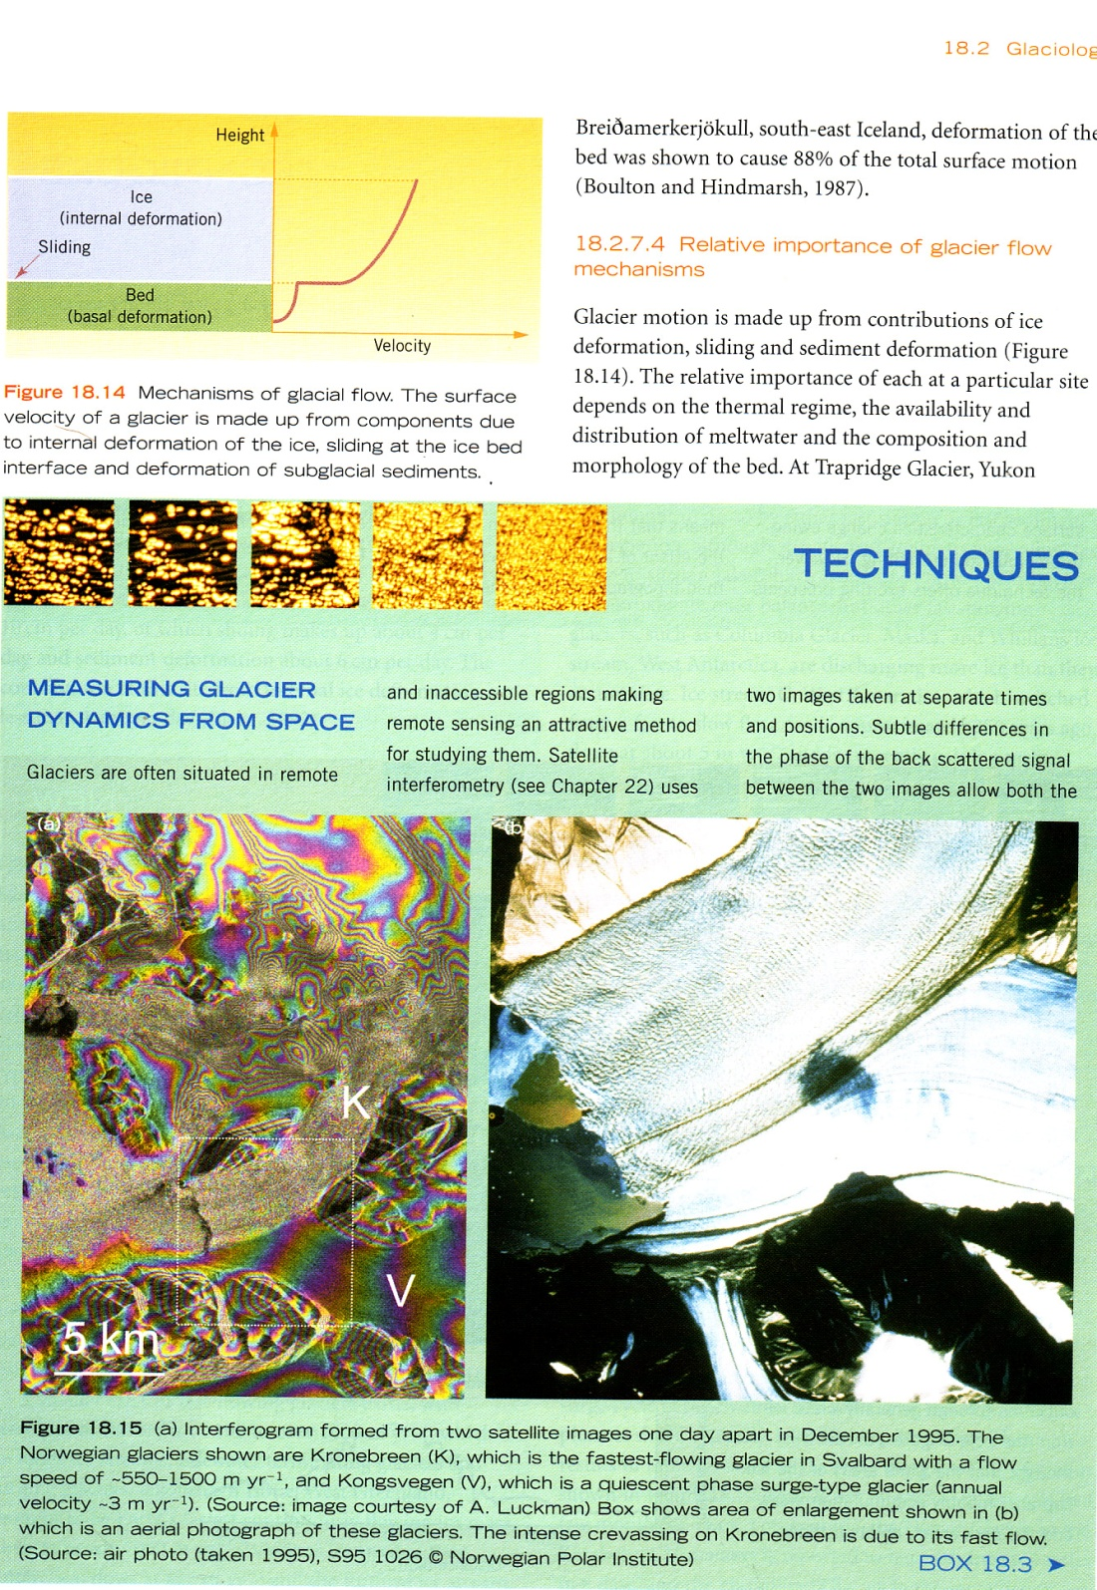
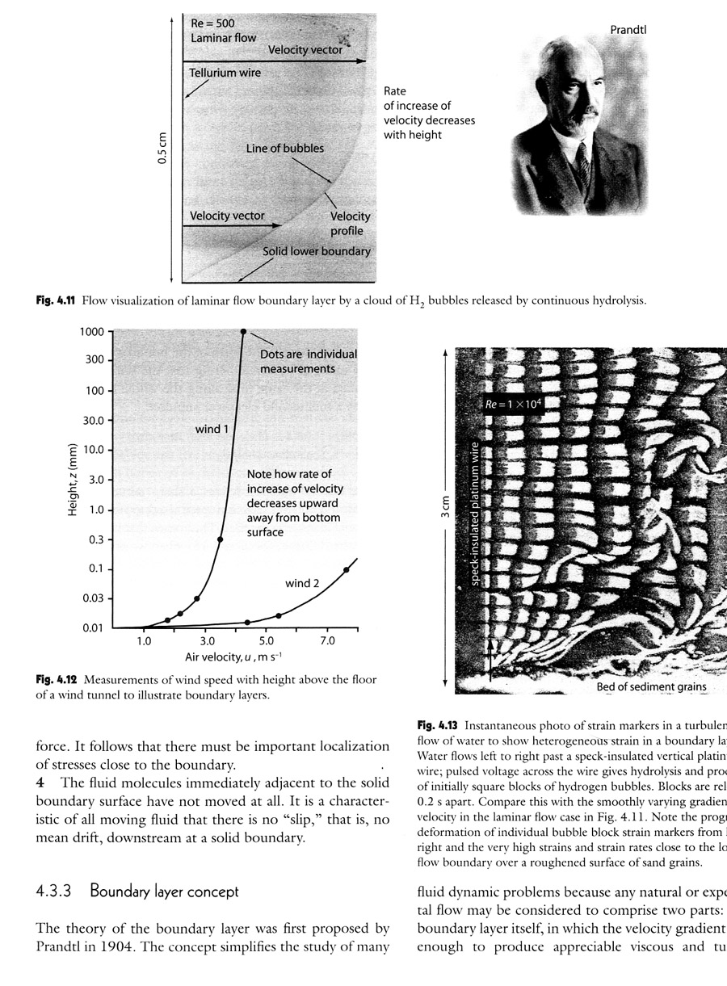
Book examples (pop)
Current examples of recent two texts

Slide 30
Challenges for ‘libraries’
Students will use their own devices
Students will not necessarily come into libraries (or even institutions!)
Students may/will want (?) textbooks on their machines
How can education be better personalised?
You may need to give more advice (to students) on ‘Apps’, facilities and DIL in general
You may/will have you work with developers and even academic staff (who tend to be TLT)
How can PLE and personalised spaces help you/us/me

Slide 31
A few things for students (and staff)
2007, TUC described the UK’s Facebook users as ‘3.5 million HR accidents waiting to happen’ (Sheffield UCU Bulletin)
Security, passwords ….
Copyright and CC
Backup and archiving
what other things might you be asked to do?
Employability skills as well as DIL?

Slide 32
Authors - and institutions
Do academics write textbooks for money?
Courses ‘produce’ textbooks
Treatises or memoires - low numbers
Periodicals and subscriptions (Open publishing)
Something to say (RAE)
Buried consequences
  Costs
  Copyright
Ways out of the dilemma?
  Self publishing, university publishing
  Re-usable Educational Objects

